Slide 1
Reminders
May 7: poster day (don’t leave!)
I’ll send out a doodle poll for times
2hr, I’ll come over each poster and ask questions
Friends of ML+OPT will be invited
I’ll send details on how to print
May 6, Sunday: Deadline for final reports
Format: same as proposal, but no length restriction
Next week: Research week
I’ll be in class for questions
No lecture
Last call for Scribes

Slide 2
ECE901
Dimitris Papailiopoulos
University of Wisconsin-Madison
Training in the face of Adversity

Slide 3
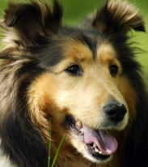

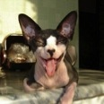
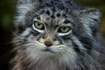



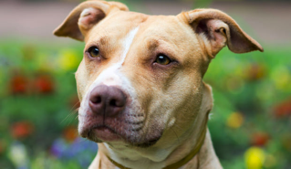
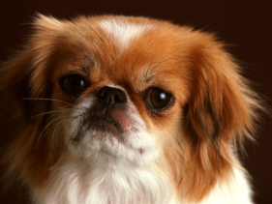

The ML pipeline
Test (unseen) Data
Input Data
Training
Model
predicted
label:
“dog”

Slide 4
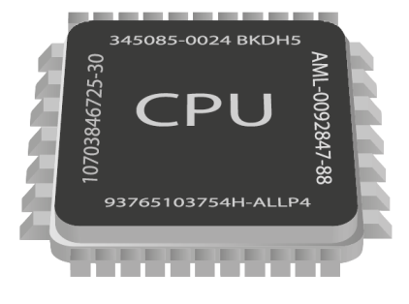
Bottlenecks in Training
Issue:
Might have millions of examples
Training on ImageNet takes 10+ days
[DawnBench, 2017]

Slide 5
Bottlenecks in Training
Issue:
Might have millions of examples
Training on ImageNet takes 0.5 hour [DawnBench, 2018] (TPU Pods)

Slide 6
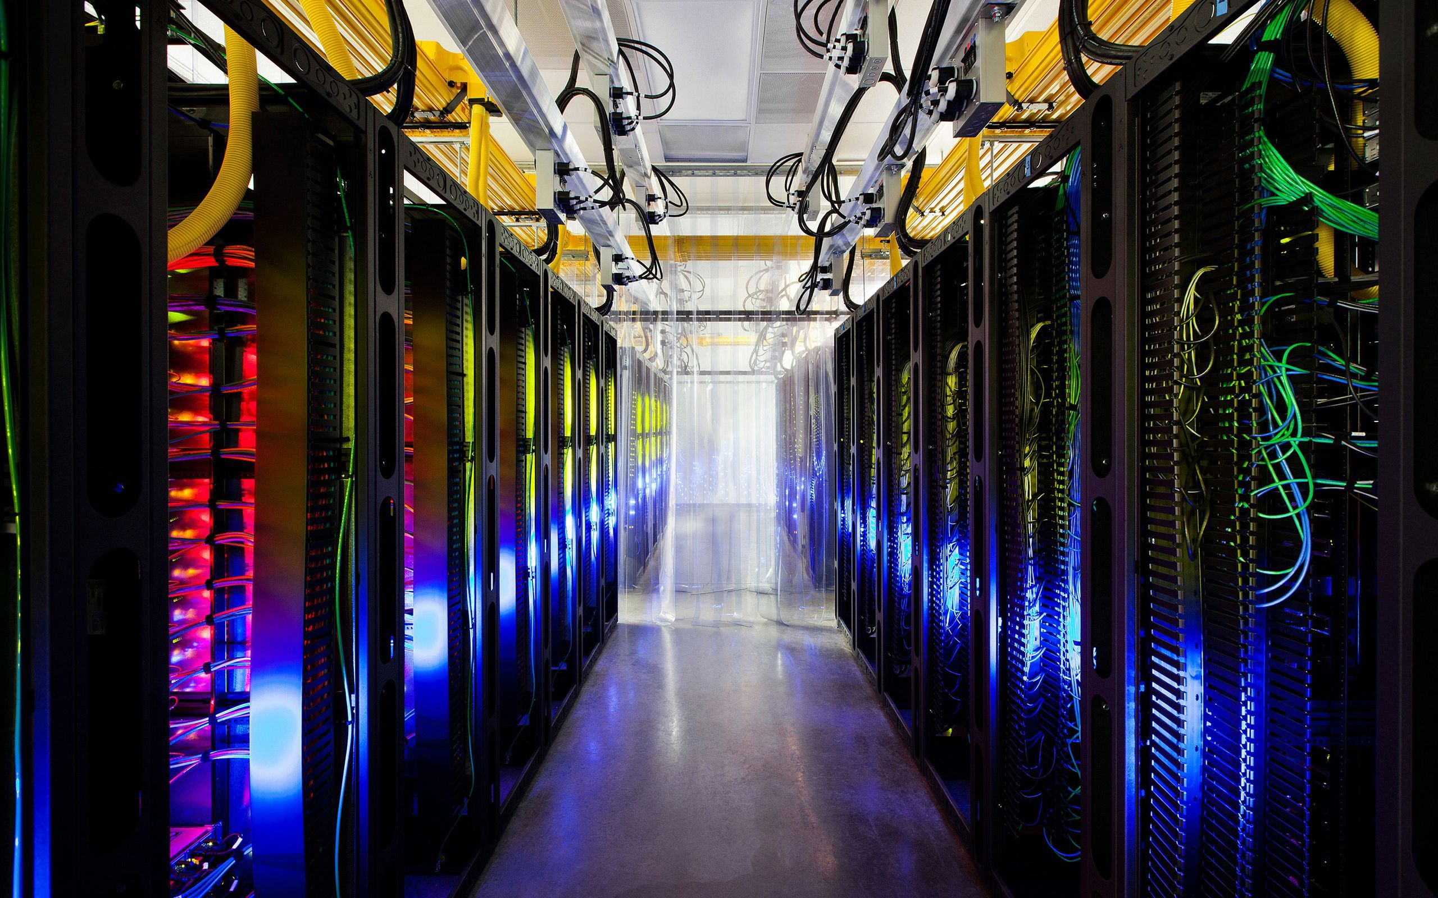
Train at scale

Slide 7
Stores the model
Gradient Computations

Slide 8
Mini-batch SGD

Slide 9
Mini-batch SGD
Batch size B:
#gradients / iteration
+
+
+

Slide 10
Mini-batch SGD
Repeat iterations until
we train a good model
[Zinkevich, Weimer, Smola, Li, NIPS 2010]
[Cotter, Shamir, Srebro, Sridharan, NIPS11]
[Dekel, Gilad-Bachrach, Shamir, Xiao, JMLR 2012]
[Friedlander and Schmidt, SIAM JSC 2012]
[Takác, Bijral, Richtárik, Srebro, ICML 2013]
[Li, Zhang, Chen, Smola, KDD 2014]
[Jain, Kakade, Kidambi, Netrapalli, Sidford, arxiv’16]
[De, Yadav, Jacobs, Goldstein, arxiv’16]

Slide 11
Challenges
beyond communication and stragglers bottlenecks

Slide 12
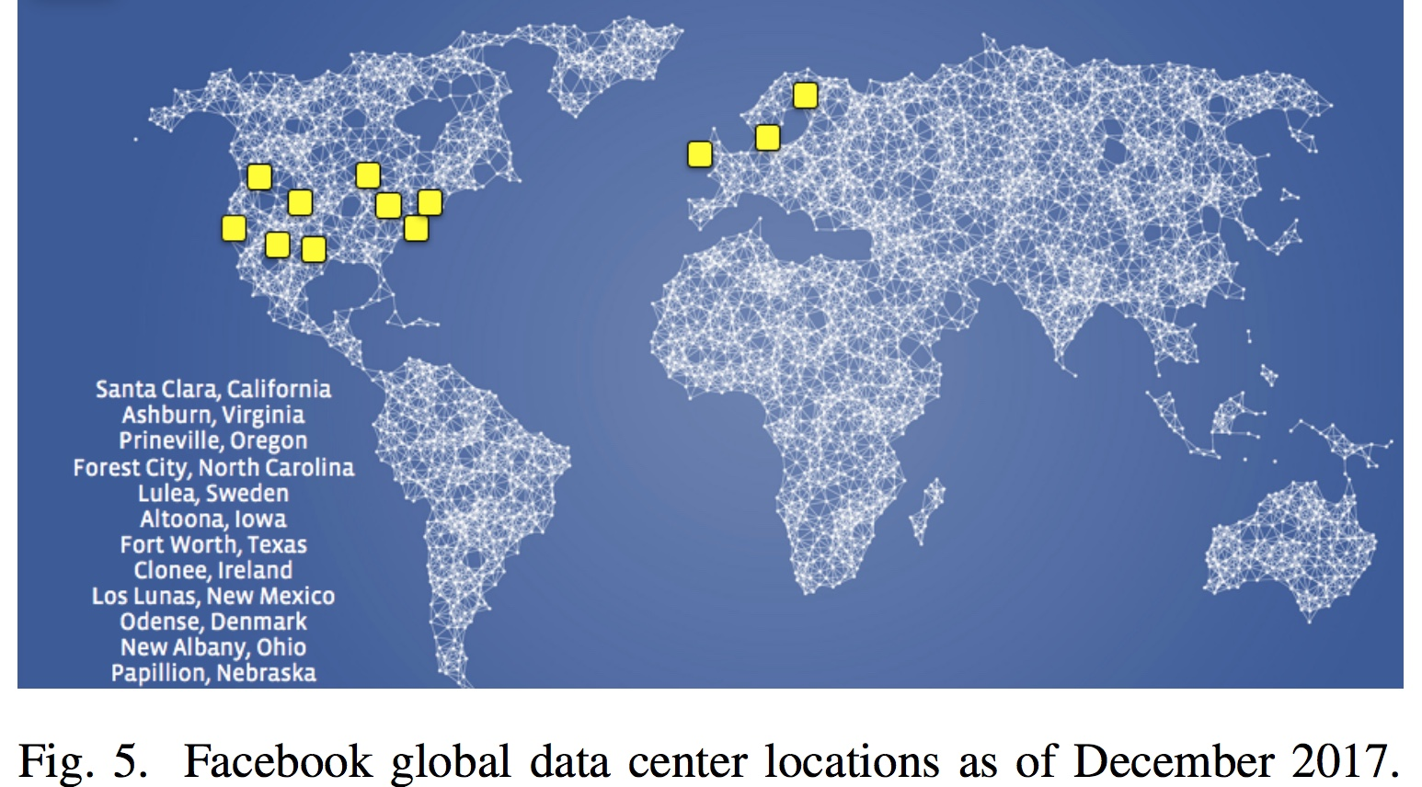
Robustness: a key Challenge
“For […] training and inference […] the importance of disaster-readiness cannot be underestimated.”
“Adversaries are constantly searching for new […] ways to bypass our identifiers […]”
Applied Machine Learning at Facebook: A Datacenter Infrastructure Perspective [fb, HPCA2018]

Slide 13
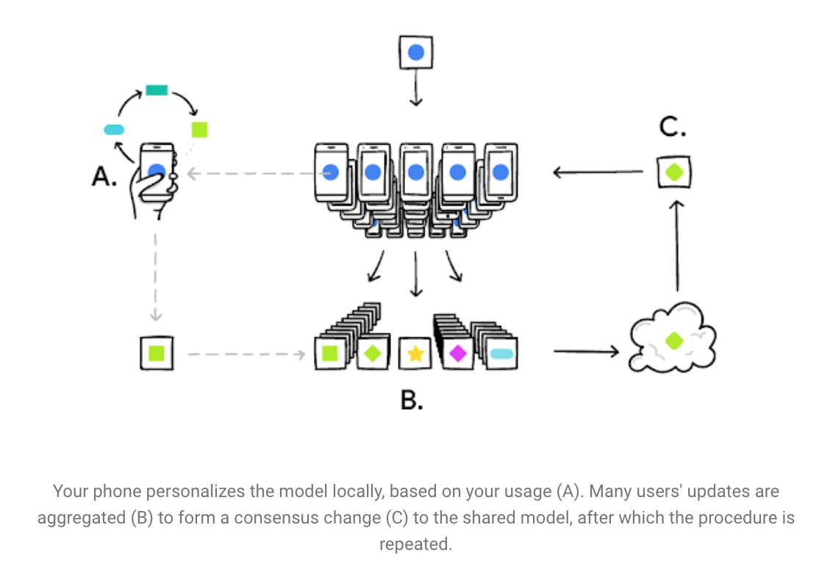
Robustness: a key Challenge
What if Adversarial?

Slide 14
Types of noise during training
Data poisoning
Original data point:
“Poisoned”
Altered data
towards a malicious goal

Slide 15
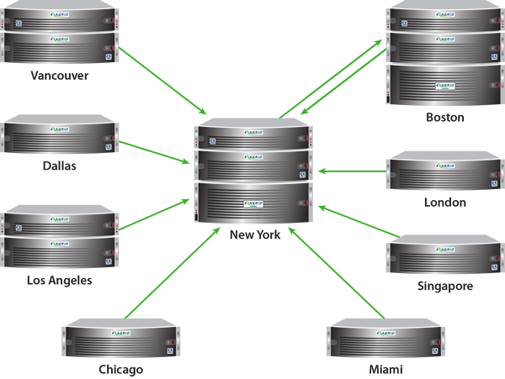

Types of noise during training
Catastrophic failures
Worst-case failures

Slide 16

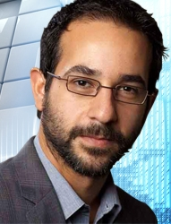
Active Adversary

Slide 17
Active Adversary

Slide 18
Types of noise during training
Data poisoning
Worst-case Failures
Active Adversary
Is SGD robust to noise?

Slide 19
Noisy SGD
Vanilla mini-batch SGD:
Noisy minibatch:

Slide 20
Noisy SGD: poisoning
Vanilla mini-batch SGD:
Noisy minibatch:

Slide 21
Noisy SGD: node failures
Vanilla mini-batch SGD:
Noisy minibatch:

Slide 22
Noisy SGD: general adversaries
Vanilla mini-batch SGD:
Noisy minibatch:

Slide 23
SGD robustness?
SGD is robust to either “very small”
or zero-mean, bounded variance noise in the gradients

Slide 24
minibatch SGD is not Robust
Lemma:
A single adversary can arbitrarily corrupt the model, even if it’s sending the “correct” direction update.

Slide 25
Can we Robustify SGD?
Robust Mean?
[Blanchard, El Mhamdi, Guerraoui, Stainer 2017]
[Chen, Su, Xu, 2017]
[Yang, Bajwa, 2017]
[Xie, Koyejo, Gupta, 2018]
[Yin, Chen, Ramchandran, Bartlett, 2018]
[Alistarh, Allen-Zhu, Li, 2018]

Slide 26
Robustifying the Mean
Coordinate-wise Median
Sort elements, pick the middle
E.g,
{1,2,3,4,5,6,7,8,9}; median = 5
{-10,2,3,4,5,6,7,8,9}; median = 5
{-10,2,3,4,5,6,7,8,19}; median = 5

Slide 27
Robustifying the Mean
Truncated Mean
Sort elements, pick average of the n/2 middle
E.g,
{1,2,3,4,5,6,7,8}; tr-mean= 4.5
{-1,2,3,4,5,6,7,80}; tr-mean= 4.5
{-80,-1,2,3,4,5,6,70}; tr-mean= 3.5

Slide 28
Robustifying the Mean
KRUM
Assume f nodes are adversarial
Complexity O(n^2d)
[Blanchard, El Mhamdi, Guerraoui, Stainer 2017]

Slide 29
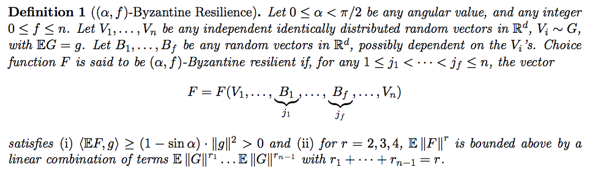
Robustifying the Mean
KRUM guarantees
[Blanchard, El Mhamdi, Guerraoui, Stainer 2017]

Slide 30
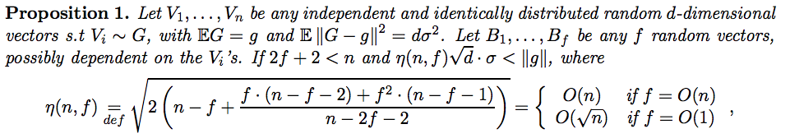
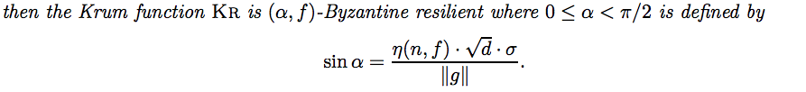
Robustifying the Mean
KRUM guarantees
Implies convergence guarantees
[Blanchard, El Mhamdi, Guerraoui, Stainer 2017]

Slide 31
Robustifying the Mean
Geometric Median (vector version of coordinate med)
Complexity O(nd log^3 1/ε)
[ log2(1/0.01)^3 =97.6 ]
[Chen, Su, Xu, 2017]

Slide 32
Robustifying the Mean
Geometric Median (vector version of coordinate med)
Complexity O(nd log^3 1/ε)
[ log2(1/0.01)^3 =97.6 ]
[Chen, Su, Xu, 2017]

Slide 33
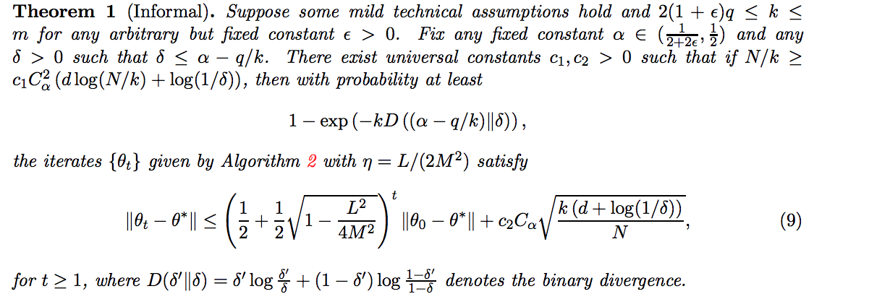
Robustifying the Mean
Geometric Median (vector version of coordinate med)
Convergence of Full-batch GD
Convex problems, with several extra assumptions
[Chen, Su, Xu, 2017]

Slide 34
Can we Robustify SGD?
can be very robust… but
“nearly” linear in theory [CLMPS16]
but expensive in practice
Convergence theory requires
many assumptions
Model not reproducible

Slide 35
Can we Robustify SGD?
Codes
Codes
Codes
Can we build a robust version of SGD that is:
+ cheap
+ black-box convergence
+ vanilla SGD model = robust SGD model
can be very robust… but
“nearly” linear in theory [CLMPS16]
but expensive in practice
Convergence theory requires
many assumptions
Model not reproducible

Slide 36

Idea: Defend via Majority
Dates back to Von Neumann
Noisy wires
Idea:
Redundancy
Take Majority Vote
1
1
1
0
chance of bit
error is δ

Slide 37
Idea: Defend via Majority
PS
Adversary

Slide 38
Idea: Defend via Majority
Majority Voting
PS
Group 1
Group 2
Adversary

Slide 39
DRACO:
Robust SGD via Coding Theory
SGD model update
Simple decoding
Ship encoded sums
Nodes compute r times more

Slide 40
DRACO:
Robust SGD via Coding Theory
SGD model update
Simple decoding
Ship encoded sums
Fractional Repetition
[Tandon et al.]
Or Fourier-based cyclic code

Slide 41
DRACO:
Robust SGD via Coding Theory
Pros:
- Small PS complexity
Draco model = SGD model
Convergence for free
Cons:
- Redundancy is wasteful
Thm1:
To tolerate s adversaries,
we need r>2s
Thm2:
Draco is optimal

Slide 42
DRACO:
Proof of Majority
Q: If I have s adversaries, when does Majority fail?
Complexity?

Slide 43
Experiments

Slide 44
Experiments
Draco
Median SGD
Cifar10
Resnet 18
45 compute nodes
m4.2xlarge instances
1, 3, 5 adversaries
PyTorch implm.
SGD
Draco ~5x faster at 88% test
Median never reaches 90%

Slide 45
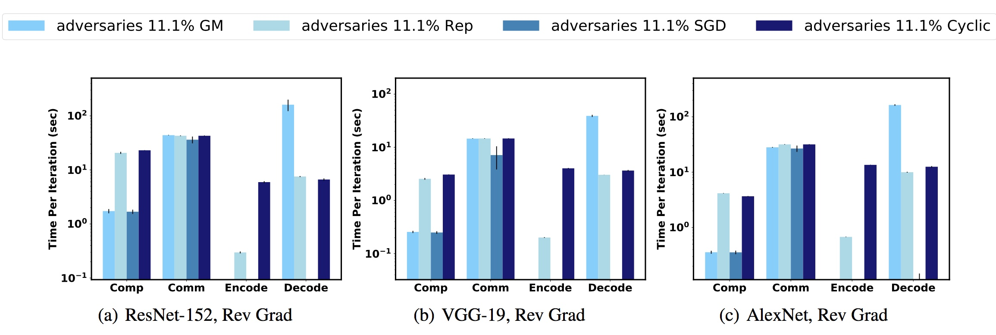
Runtimes on ImageNet Models
Draco
Draco
Median SGD
Median SGD
Draco ~5x slower during compute
Median ~20x slower during averaging

Slide 46
Open Challenge: Privacy
Can we enable private data shuffling??

Slide 47
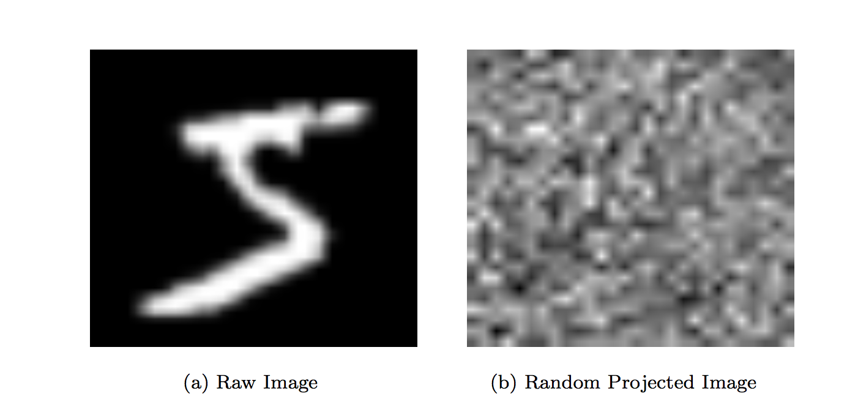
Private Data Shuffling ?

Slide 48
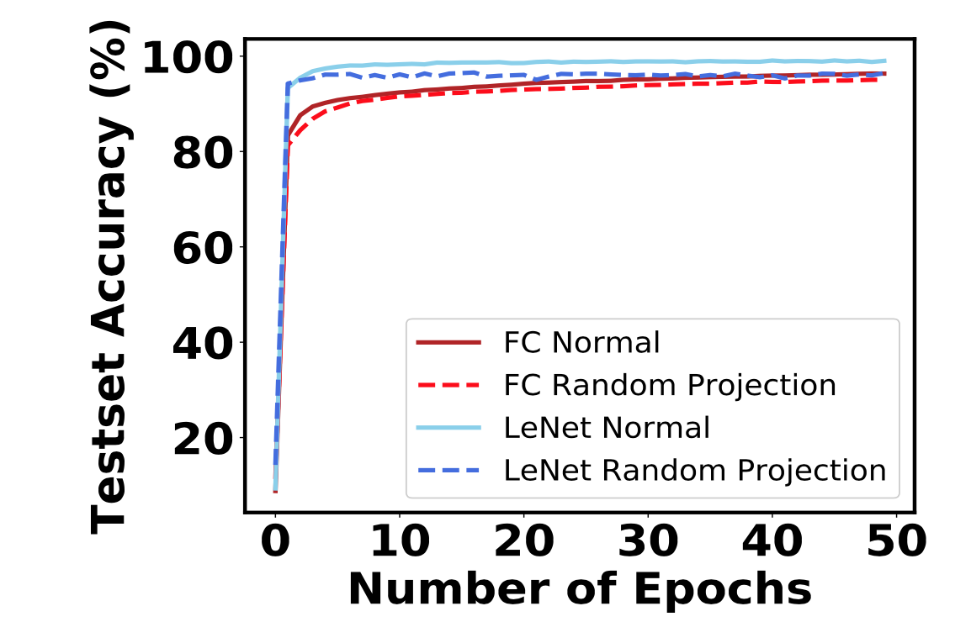
Private Data Shuffling ?
Provable Privacy?
Tradeoff between “learnability” and privacy

Slide 49
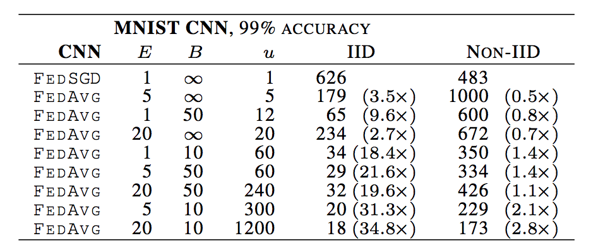
Impact of Private Shuffling
Shuffling would allow faster convergence (10x)
[McMahan, Moore, Ramage, Hampson, Aguera y Arcas, 2016]

Slide 50
Open Problems
Replication requires data sharing
Not cool for federated learning!
Data obfuscation?
r>2s very strict
Any better if we allow approximation?
Median + Codes?

Slide 51
What do Codes do?
Exploit redundancy, to “robustify” against uncertainty

Slide 52
Applications:
Wireless Comm.
Storage
Encryption
Hardness Theory
Machine Learning

Slide 53
Coding Theory for Machine Learning
Stragglers
Communication Bottlenecks
Adversaries and Robustness
Many Open Problems. What’s Next?
[Lee, Lam, Pedarsani, P, Ramchandran, 2016] [Li, Maddah-Ali, Yu, Avestimehr, 2016]
[Dutta, Cadambe, Grover, NIPS 2016] [Attia, Tandon, 2016]
[Tandon, Lei, Dimakis, Karampatziakis, ICML 2016 ] [Song, Fragouli, Zhao, ISIT 2017]
[Yu, Maddah-Ali, Avestimehr, NIPS 2017] [Raviv, Tamo, Tandon, Dimakis, 2017]
[Ferdinand, Draper Allerton 2016] [Kabir, Sala, Van den Broeck,Dolecek]
[Karakus, Sun, Diggavi, NIPS 2017] [Bitar, Parag, El Rouayheb, ISIT 2017]
[Park, Lee, Sohn, Suh, Moon] [Rawat, Mazumdar, 2018]

Slide 54
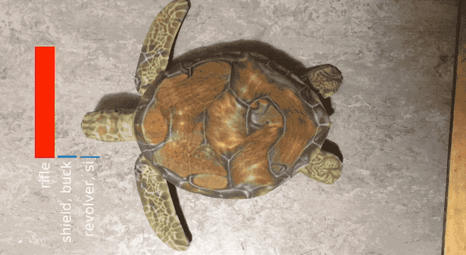
The Challenges of Deep Learning
Can become the new successes
of Coding Theory?

